Slide 1
Research Methods: Literature Review Dr. Bhuva Narayan University of Technology Sydney

Slide 2
Process 1. Broad research questions or research area 2. Literature search 3. Annotated bibliography 4. Conceptual framework 5. Literature review 6. Specific research question or problem identified

Slide 3
Do you already have a Research Question?

Slide 4
Problems with formulating a question
The “elevator speech” problem: You cannot tell me which question you are asking unless you engage in a five-minute monologue. By which time I would have already left the elevator.
A good research question is simply a short question. You should not need to elaborate for five minutes on this question or to explain the components of the question. Doing so indicates that you have not yet fully grasped what the essence of the problem is, or you have not yet fully discovered how you can scope your research question in a way that you can easily distinguish from related phenomena or problems.

Slide 5
The “so what” problem: You have a research question, but it simply doesn’t matter to anyone. Research in an applied discipline such as information science “apply” knowledge to practical problems. Hence, there should be practical merit (utility) in the research. You notice that you may have a so-what problem if you have trouble motivating and justifying your questions.

Slide 6
The “solving-the-world” problem: Your research question is indeed important. But it simply cannot be answered given the resource constraints - it’s basically only you – and/or the time constraints, and typically you will certainly not get to know enough to find the solution to large problems.

Slide 7
The “insolvability” problem: Your question simply cannot be answered meaningfully in the time you have. Sometimes this is because of a logical problem in the question, because the information needed to answer the question cannot be logically or legally obtained, or because the answer is so hard to obtain that feasibility of the research within the constraints is not possible. A good example is that of longitudinal studies (research that examines the evolution of phenomena over time).

Slide 8
The “multitude” problem: You are simply asking too many questions. In turn, most of your questions are too narrow, too irrelevant, too grand, or otherwise deficient. A good study sets out to answer one question. Maybe two if you are ambitious. Nothing is gained by setting out to answer six questions. Most likely, most of them will fall under the category of ‘not proper research questions.’

Slide 9
So what are ‘not proper research questions’?
Obvious questions: “Are there challenges in using information technology?” Of course there are. Obvious questions have answers to which everyone would agree.
Irrelevant questions: “What is the influence of weather on the salaries of information professionals?” There is no reason to believe that there is any influence whatsoever.
Absurd questions: “Is the earth flat after all?” Absurd questions have answers but…
Definitional questions: “Is political conflict characterised by disagreement?” That is simply a matter of creating a concept that says it does. Definition is a mere form of description, not research.
Affirmation questions: “Can a decision-support tool be developed to facilitate decision-making for senior information managers?” I sure hope so. There is no reason to believe that it cannot be done.

Slide 10
Guiding questions to find research questions
Do you know in which field of research the research question(s) is/are?
Do you have a firm understanding of the body of knowledge in that field (how well do you know the relevant domain literature)?
What are the important established research questions in the field?
What areas need further exploration?
Could your study fill an important gap? Will it lead to greater understanding?
How much research has already been conducted in this topic area?
Has your proposed study been done before? If so, is there room for improvement?
Is the timing right for the question to be answered? Is it a sustainable and important topic or is it currently hot but at the risk of becoming obsolete (a fad)?
Who would care about obtaining an answer to the question? What is the potential impact of the research you are proposing? What is the benefit of answering your research question? Who will it help, and how will it help them?
Will your proposed study have a significant impact on the field?

Slide 11
Types of research
Pure research (often deductive; science)
Original/Primary research (often inductive; social sciences)
Secondary research (often abductive; making new connections; transdisciplinary)
Directed research (has a specific purpose; solves a specific problem)
Non-directed research (Blue sky research; finding out things for the sheer fun of it; aids discovery)

Slide 12
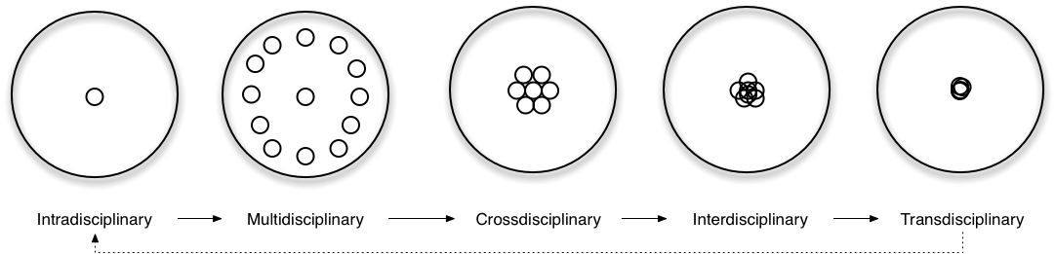
Methodological frameworks
Bricolage, a pluralistic methodological strategy
Interdisciplinary and multidisciplinary
Multiple-methods approach
Boundary work
Image © Jensenius http://www.arj.no/wp-content/2012/03/interdisciplinary.png

Slide 13
Types of research questions
“What”, “who,” and “where” questions tend to focus on issues where we seek to explore and describe a topic where little knowledge exists to date.
“How” and “why” questions are explanatory and seek to provide an answer about the causal mechanisms that are at work regarding a particular phenomenon.

Slide 14
Structuring your research question
A managerial question states the driving question of the study.
A research question captures the general purpose of the study. It is derived from the managerial question, and translates it into a research problem.
An investigative question then identifies question(s) that must be answered in order to address the research question(s) more precisely.

Slide 15
Justifying a research question
Feasible: Adequate subjects of study are available, technical expertise is available, time and money are available, and the scope is manageable.
Interesting to the investigator: You are confident that you can maintain an interest in the topic and maintain your own motivation to study. If you are not interested in pursuing the answer to the question, no one will be interested in hearing about the results.
Novel: An answer to the question will confirm or refute previous findings or provide new findings.
Ethical: Pursuing and answering the question will not violate ethical principles for the conduct of research, and will not put the safety of the investigators or subjects at risk.
Relevant: both the question and the future answer(s) are important in the sense that they inform knowledge, industry practice, and future research directions.

Slide 16
Literature Reviews

Slide 17
Why a literature review?
Improve your own understanding of the topic
Demonstrate your understanding of the topic and your analysis skills (treat the literature as your data and analyse it as you would analyse your data)
Update your reader on the current understanding on your topic
Situate your own research and establish its importance

Slide 18
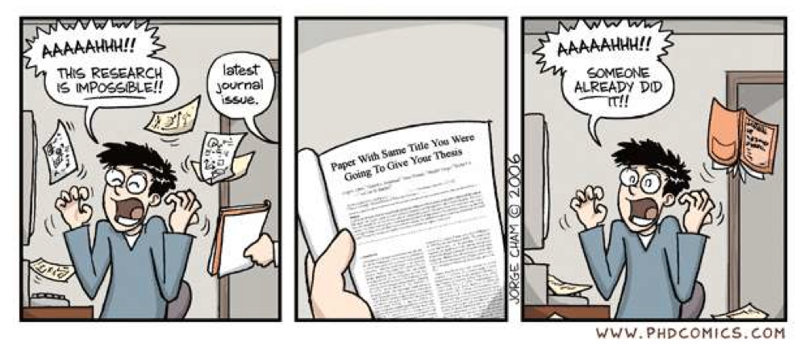
Why? Because...

Slide 19
A literature review can be...
a list of relevant theories;
a search for relevant information;
a survey of writing on the subject;
a way of learning about the subject;
a help in finding dissertation topics and research methods;
a help in finding research questions;
an important component of a dissertation or report.
Adapted from Bruce (1994)

Slide 20
What a Literature Review is NOT
An essay/paper: it does not state or prove your main points
A review of the literature
An annotated bibliography / Series of abstracts
A description or summary of others work
A book report of the literature / Summary
Notes:
Maintain an annotated bibliography as a memory bank of everything you have read, for your own reference.

Slide 21
What a Literature Review is NOT (2)
A narrow focus just on the published literature (include not just published papers, but also unpublished works such as dissertations, grant applications, exploratory research, pilot studies)
[learn how to cite interviews, e-mails, tweets, social media etc.]
Not a source of authority to be deferred to, but a useful but fallible source of ideas about what’s going on, and is an attempt to see the alternative ways of framing the issues.

Slide 22
What a Literature Review IS
A snapshot of the major concepts within the major works in your ‘narrow’ topic
An examination of the relationships between these major concepts
A Conceptual framework (Concept: an abstraction of common characteristics from several ideas; a construct)
An idea context
Notes:
e.g., biologist Bernd Heinrich who used concepts like individual effort, competition, and division of labour from Adam Smith’s Wealth of Nations and applied them to Bumblebees.
e.g., Aiden Dipple’s dissertation in progress on stigmergy (a process by which ants build networks) in online networks.

Slide 23
What a Literature Review IS (2)
An evaluative comparison
A critical review of problems (including ethical problems) there have been with previous research and theory, what contradictions or holes you have found in existing views.
An integration of approaches, lines of investigation, and theories that nobody else has connected before (it can be from across disciplines)
Establishing the need for your research / Formulating your research question
Notes:
e.g., biologist Bernd Heinrich who used concepts like individual effort, competition, and division of labour from Adam Smith’s Wealth of Nations and applied them to Bumblebees.
e.g., Aiden Dipple’s dissertation in progress on stigmergy (a process by which ants build networks) in online networks.

Slide 24
What a Literature Review IS (3)
A Theoretical Framework (Theory: a model or a map of concepts joined by a “proposed” relationship; “Theory is a coat closet, you can hang anything in it” –Jane Margolis, UCLA)
A theory in itself
A theory that informs your research design & connects it to a research paradigm
Notes:
e.g., biologist Bernd Heinrich who used concepts like individual effort, competition, and division of labour from Adam Smith’s Wealth of Nations and applied them to Bumblebees.
e.g., Aiden Dipple’s dissertation in progress on stigmergy (a process by which ants build networks) in online networks.

Slide 25
The process of searching the literature should answer these questions:
What is already known about this area?
What concepts and theories are relevant?
What research methods and strategies have been used in this area?
Are there any controversies?
Are there any inconsistencies in findings?
Are there unanswered questions?

Slide 26
So, you write a literature review because.....
you need to know what is already known about your research area;
you can learn from the mistakes of others;
you can learn about different theoretical and methodological approaches to your research area;
it may help you to develop an analytic framework;
it may lead you to consider including variables in your research of which you might not have thought;
it may suggest further research questions;
it is required!

Slide 27
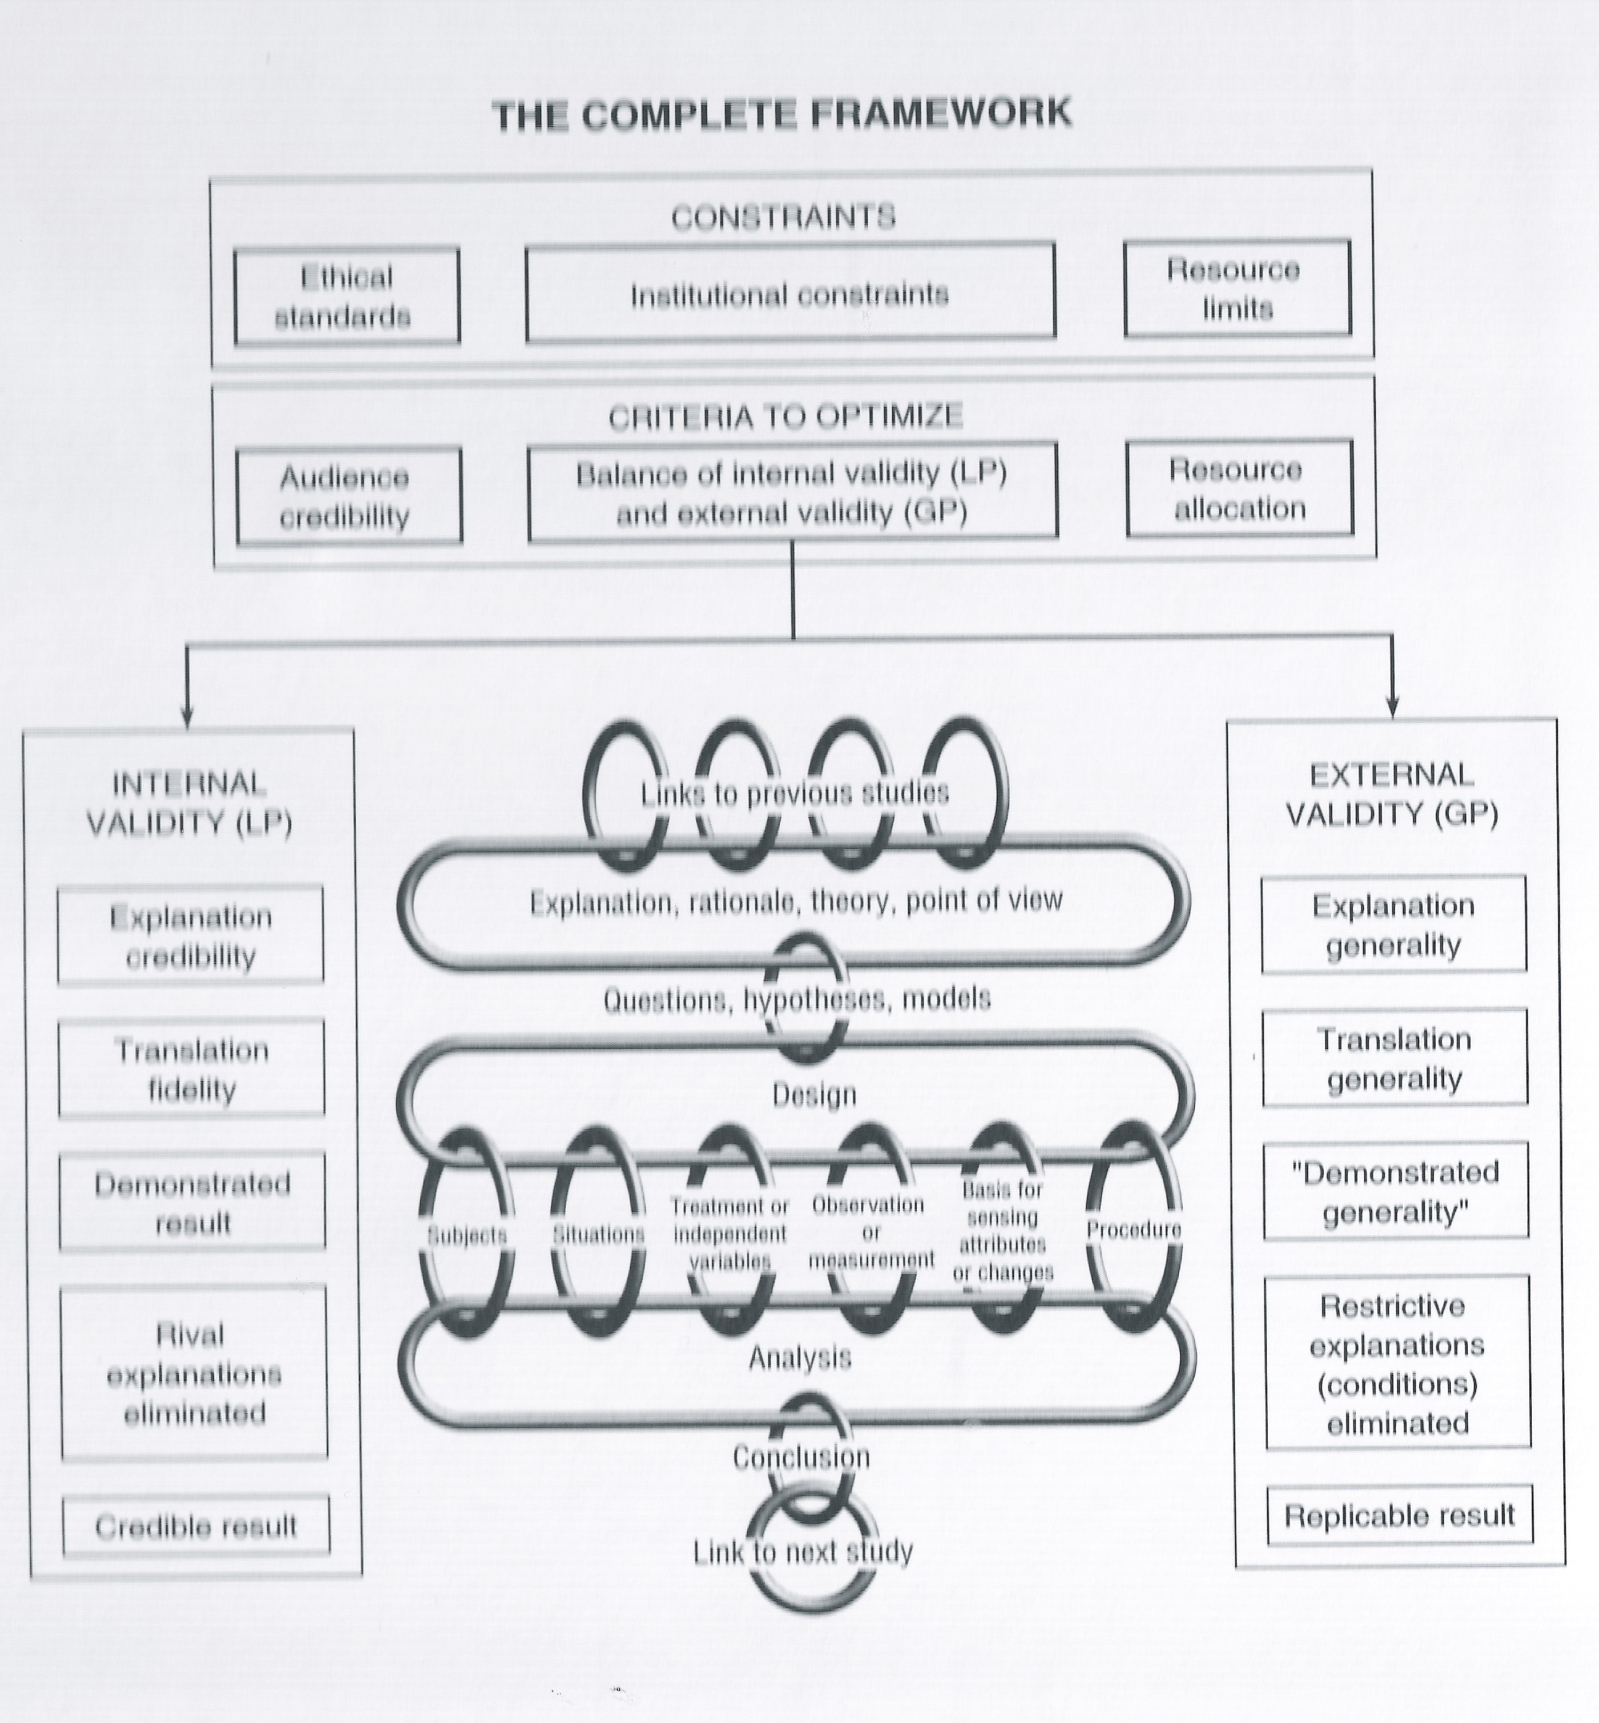
Figure from Krathwohl, David (2009). Methods of educational and social science research: the logic of methods. Long Grove, IL: Waveland Press
NOTE: Not all disciplines require a literature review. Look here for a sample list: http://www.flinders.edu.au/slc_files/Documents/Brochures/lit_review.pdf

Slide 28
Tools for managing your citations
Endnote (via UTS library or Endnote Online)
http://www.mendeley.com
http://www.bibme.org
http://www.lib.ncsu.edu/citationbuilder
http://www.citethisforme.com/
http://www.refworks.com/ (You can get a Group Code from UTS library site to use this from home)

Slide 29
The classical dissertation structure
INTRODUCTION What I want to do
LITERATURE What others say about it
DESIGN My plan for doing it
RESULTS What happened when I did it
DISCUSSION What this means
CONCLUSIONS What I found out

Slide 30
Literature to Research Design
Logical, consistent growth of ideas across the research paper
Introduction Purposes
Literature Framework
Research Design Methodology /Methods
Results Analysis
Discussion Reflection
Conclusions Future Directions

Slide 31
Literature to Research Design
Literature Thesis (proposition)
Results Antithesis (counter-proposition)
Discussion Synthesis
Literature/Thesis provides framework for the research
This has effect on research design
- methodology
- instruments
- analysis

Slide 32
Design to Literature
The literature can be considered part of the research design:
INTRODUCTION What I want to do
DESIGN My plan for doing it
LITERATURE Initial theory from literature
RESULTS Findings in relation to literature
DISCUSSION Constructing a new theory
CONCLUSIONS What I found out

Slide 33
Where to begin?
Consult our primary, secondary, and tertiary sources (thesaurus, encyclopedia, textbooks, survey of research such as ARIST) to identify search terms, vocabulary, and descriptors)
Footnote chasing: Search footnotes and endnotes of pertinent works
Search for other works by authors you have found relevant
Remember that the best and most important research is often in books (seminal books) that are not online!
Search online journals such as First Monday and Information Research
Search book reviews
Search literature reviews from other research papers, dissertations, and published works
Write to famous researchers with questions. They are very happy to hear from students.

Slide 34
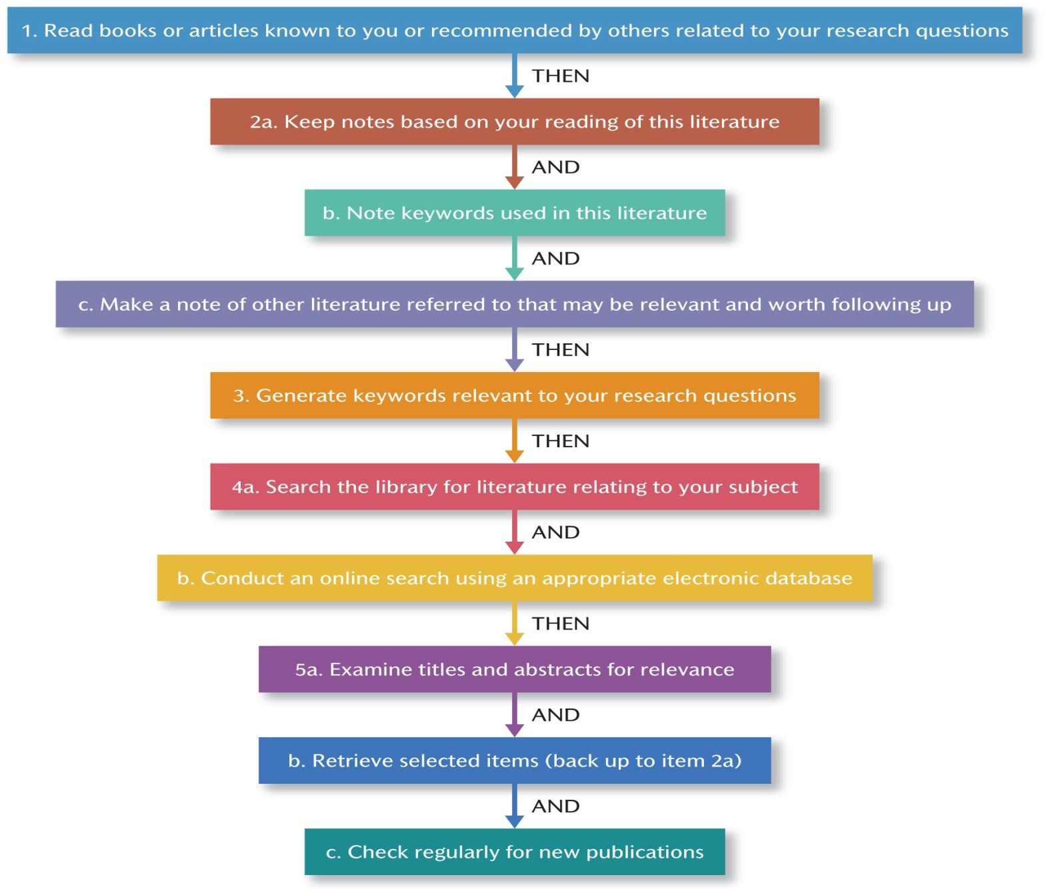
One way of searching the literature

Slide 35
SCOPUS
Do you all know how to use it?
This is a great database to begin with.

Slide 36
What to look for? 1
What to look for in the literature: Concrete interpretive details
Look for author’s core question
Look for author’s answer (aka. “thesis”)?
What subordinate or subtopics appeared or have emerged?
What, if any, “schools of thought” does this work fit within? In other words, what abstract patterns do you detect?
Evaluate research design, approaches, data-gathering, and analytical methodologies.
What weakness or gaps or unanswered questions exist or emerge?

Slide 37
What to look for? 2
What to look for in the literature: Abstract interpretive details:
Be aware of the tentative nature of research findings and “truth” claims
Note self-critiques and limitations rendered by researchers
Take care when evaluating causality
Look for trends and connections among and between research sources

Slide 38
Why?
A literature review:
Declares you can defend your idea
Shows that you know what is currently known about your topic
Shows where your future contribution fits in or will add

Slide 39
How?
Through......
putting material together which is not usually related (synthesised coherence);
building up separate items into a consensus (progressive coherence);
showing lots of related contributions but no overall agreement (non-coherence);
revealing a gap in the literature;
developing a new perspective;
showing the existing literature to be simply wrong. (Golden-Biddle and Locke, 1997:43).

Slide 40
Two main approaches to a literature review
Systematic review:
a) Very extensive search of the specific research field;
b) Grouping of sources into categories:
* very relevant, based on good research,
* very relevant, weak research,
* low relevance, or too general;
c) Giving a step-by-step report on the search method used, decisions taken and derived conclusions. (Tranfield et al, 2003:209)

Slide 41
Two main approaches to a literature review
2. Narrative Review:
a) Limited search for the most interesting contributions;
b) Concentration on connections between sources located and research questions;
c) Revision of research questions in the light of readings.

Slide 42
Systematic or narrative review?
Narrative:
“Quality” focus;
Theory emerges from the search;
Identifying the discourse is the research goal.
Systematic:
Positivist;
“Quantity” focus;
Theory informs the search;
Synthesis is the research goal.

Slide 43
Techniques 1: Meta-analysis (in Quantitative Research)
Pooling the results from various studies in order to estimate the overall effect of a particular variable by correcting the various methodological errors of individual studies.

Slide 44
Techniques 2: Meta-ethnography (in Qualitative Research)
Relating various qualitative studies to each other to produce a synthesis. The usual criteria for selection are credibility and interest-level. Through repeated readings of the selection, a number of characteristics of the observed phenomenon emerges.

Slide 45
Narrating your review
Make your ‘voice’ clear
You are the informed moderator for the debate/ discourse on the topic that is taking place between the authors in the literature
You are the narrator of the story
Your perspective, position or standpoint, should be clearly identifiable in the literature review
Your theoretical position should be clearly and strongly stated
Hermeneutic approach (read Sebastian Boell's article –handout)

Slide 46
Organising your review
Chronological
Advancements
Geographical
Classical (major writers and seminal, landmark or benchmark studies)
Topical of thematic
Inverted pyramid
Intersections / adjacencies
Around Major questions

Slide 47
Kinds of structures

Slide 48
Organising your review
Chronological
Advancements
Geographical
Classical (major writers and seminal, landmark or benchmark studies)
Topical of thematic
Inverted pyramid
Intersections / adjacencies
Major questions

Slide 49
Structure: INTRODUCTION
Identify the topic
Clarify important definitions/terminology
Craft an argument for why the topic is important/relevant to the field
Comment on the general nature and current state of the literature
Narrow the problem
Articulate one overarching core (super-ordinate) question encompassing all of the literature you have covered to this point – this is your literature review question (not your research question)
Pose one answer (a thesis) to that question that the literature has collectively advanced thus far
Write a draft but rewrite introduction after completing review

Slide 50
Structure: BODY
Write a critical REVIEW ESSAY that logically connects and transitions from one point to the next (using scholarly sources as your material)
List the criteria you are using to “accept” a study as relevant to your own research
Point out strengths and weaknesses of each source, and point out contradictions and inconsistencies across all the evaluated literature
Provide your reader with a summary at the end of a long section

Slide 51
Structure: BODY
Critical evaluation – balanced assessment
(not only pointing out negatives – critiquing)
Involves
Examining assumptions.
Questioning and challenging ideas.
Using one reference to critique another.
Judging validity and worth of evidence.
Providing evidence for your claims.
Forming opinions / arguments.
Making connections by cross-referencing.
Making connections to your topic
SO WHAT question!

Slide 52
Structure: CONCLUSION
Provide your reader with a summary that restates the larger overarching (super-ordinate) question and the answer/thesis you detected across all the literature
Based upon your analysis of the current literature, pose a new and original super-ordinate question that future research (your research) should investigate based on ideas about what this might be from the gaps you saw emerge from all the literature examined thus far.

Slide 53
Structure: REFERENCES
Frequently consult an appropriate style guide (this is not just for the reference list but also for how to use quotations and extracts). In Information Science, the most common is APA (American Psychological Association style).
IMPORTANT: Items in the reference list should include only sources actually cited in the literature review, not sources simply examined.
Remember the difference between a REFERENCE LIST and a BIBLIOGRAPHY.

